Slide 1
IMPLEMENTATION OF SMART TRAFFIC ECO OPTIMIZATION
NAME:A. SUJITHA
REG NO:192211824
NAME:AISWARIYA.R
REG NO:192210483

Slide 2
INTRODUCTION
The unprecedented growth of urban populations has resulted in significant challenges related to traffic congestion and environmental degradation.
Cities worldwide face increasing demands on their transportation infrastructures, leading to longer commute times, higher fuel consumption, and increased emissions.
Addressing these issues requires innovative solutions that integrate modern technology with sustainable practices.
Smart Traffic Eco Optimization (STEO) is a pioneering approach designed to manage traffic flow efficiently, reduce environmental impact, and enhance road safety.
By leveraging advanced technologies such as sensors, big data analytics, machine learning, and vehicle-to-everything (V2X) communication, STEO aims to create smarter and more sustainable urban transportation systems.
Sensors installed on roads and vehicles collect real-time data on traffic conditions, which is then processed and analyzed using big data techniques.

Slide 3
OBJECTIVES
Optimize Traffic Flow: Improve the efficiency of traffic management to reduce congestion and travel times
Reduce Environmental Impact: Lower vehicle emissions and fuel consumption through optimized traffic systems.
Enhance Road Safety: Increase road safety by implementing intelligent traffic control and real-time hazard alerts.
Promote Eco-Friendly Transportation: Encourage the use of electric and hybrid vehicles and eco-driving practices.
Improve Urban Mobility: Enhance the overall mobility experience for residents in urban areas.
Utilize Advanced Technologies: Leverage sensors, big data analytics, machine learning, and V2X communication to manage traffic dynamically.
Implement Adaptive Traffic Signals: Use real-time data to adjust traffic signal timings and improve traffic flow.

Slide 4
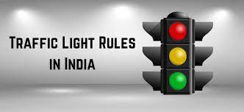
ABSTRACT
The simulation study introduce a smart traffic Eco optimization design to minimize traffic consumption into the potential of smart traffic ECO optimization system
The optimization of traffic signal operation system plays a pivotal role
Pivotal role can refers a turning point and changes in direction
It is playing a pivotal in energy efficiency sustainable and transportation .

Slide 5
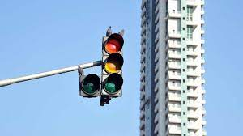
PROBLEM STATEMENT
Lack of adaptability dynamically adjust traffic signal control in response to
to changing traffic condition and environmental
variables
Fuel wastages Traffic signal timing and implementation smart traffic
management system can reduce fuel wastages due
unnecessary stops
Increased emission implementing smart traffic signal system and
promoting eco friendly transportation options can
help reduce increased emissions

Slide 6
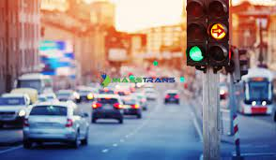
DISADVANTAGES OF EXISTING SYSTEM
The existing traffic signal system operate on fixed signal timings pre-determined
They already used other algorithms like CNN,SVM and So on.
based on historical traffic patterns and general time of day considerations
while the system are effective to a certain extent, They lack adaptability to real time traffic conditions and environmental considerations.

Slide 7
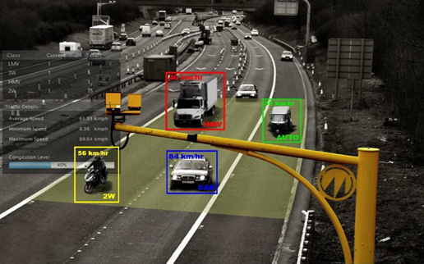
ADVANTAGES OF Proposed system
HERE BY I AM USING RANDOM FOREST ALGORITHM
This algorithm is used faster rather than other algorithms.
Data Collection: Collect data related to traffic patterns, vehicle emissions, road conditions, weather, and other relevant factors.
Ensure that the data is labeled with eco-optimization goals, such as reducing emissions.
Model Training: Train a Random Forest regression model using the training data. Random Forest is suitable for this task
it can handle non-linear relationships and interactions between features effectively

Slide 8
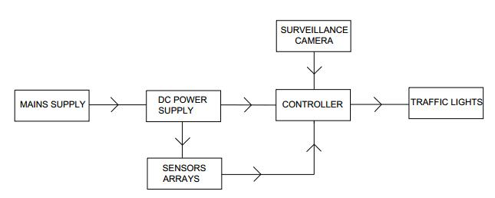
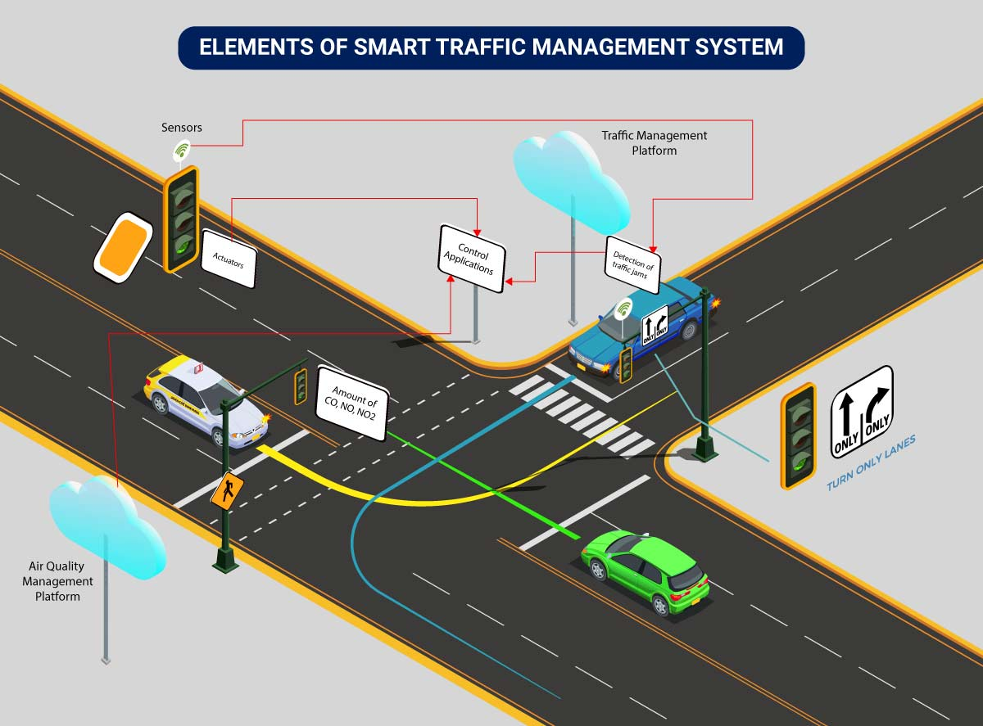
DESIGN

Slide 9
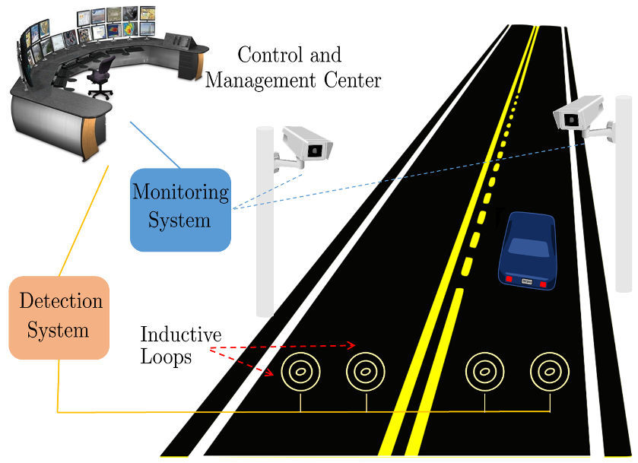
IMPLEMENTATION
import time
import random
RED_LIGHT_DURATION = 30
GREEN_LIGHT_DURATION = 30
class TrafficLight:
def __init__(self, name):
self.name = name
self.state = 'RED'
self.time_remaining = RED_LIGHT_DURATION
def update_state(self):
if self.state == 'RED':
self.state = 'GREEN'
self.time_remaining = GREEN_LIGHT_DURATION
else:
self.state = 'RED'

Slide 10
self.time_remaining = RED_LIGHT_DURATION
def countdown(self):
if self.time_remaining > 0:
self.time_remaining -= 1
else:
self.update_state()
def __str__(self):
return f"{self.name} Light: {self.state} ({self.time_remaining}s remaining)"
class TrafficSystem:
def __init__(self):
self.lights = [
TrafficLight("North-South"),
TrafficLight("East-West")
]

Slide 11
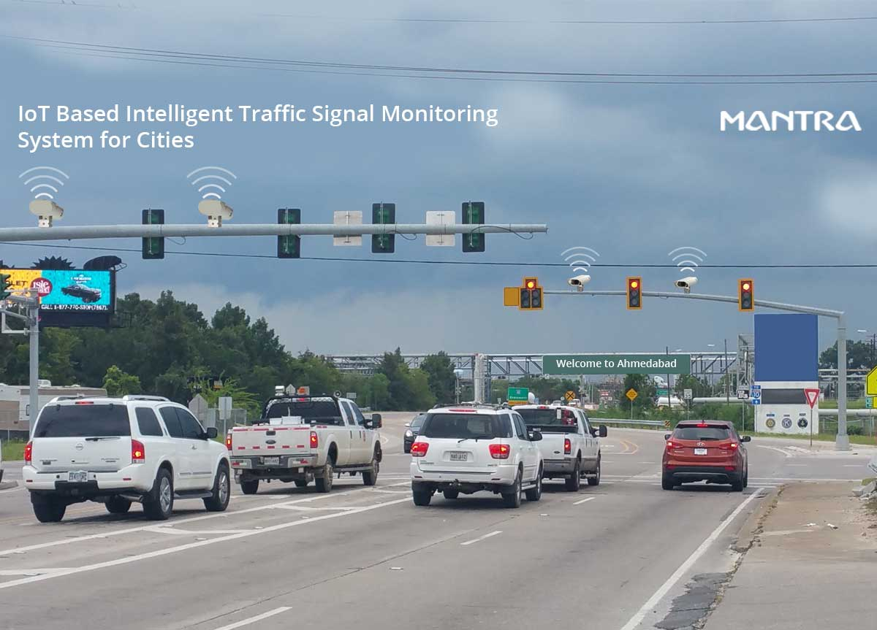
def simulate_traffic(self):
while True:
for light in self.lights:
light.countdown()
print(light)
# Simulate changes in traffic flow
self.adjust_traffic_lights()
print("\n" + "-"*40 + "\n")
time.sleep(1)
def adjust_traffic_lights(self):
# Simulate adjusting traffic lights based on random traffic conditions
if random.random() > 0.5:

Slide 12
# Randomly switch light durations to simulate traffic conditions
for light in self.lights:
if light.state == 'RED':
light.time_remaining = RED_LIGHT_DURATION - random.randint(0, 10)
else:
light.time_remaining = GREEN_LIGHT_DURATION - random.randint(0, 10)
if __name__ == "__main__":
system = TrafficSystem()
system.simulate_traffic()

Slide 13
METHODOLOGY
Planning and Design:
Conduct feasibility studies and traffic flow analysis to identify critical areas.
Design the infrastructure layout and determine the placement of sensors and communication devices.
Infrastructure Development:
Install sensors, cameras, and communication devices at strategic locations.
Upgrade traffic signals to adaptive systems and establish control centers.
Data Collection and Integration:
Collect real-time traffic data from various sources, including road sensors, cameras, and GPS data from vehicles.
Integrate data from traffic control centers, public transportation systems, and weather conditions.

Slide 14
Data Processing and Analysis:
Use big data analytics to process vast amounts of traffic data and identify patterns.
Employ machine learning algorithms to predict congestion and optimize traffic signals.
Traffic Management and Optimization:
Implement adaptive traffic signals that adjust timing based on real-time traffic conditions.
Utilize intelligent traffic control centres to monitor and manage traffic flow dynamically.
Communication and Feedback:
Enable vehicle-to-everything (V2X) communication to enhance traffic coordination.
Provide real-time feedback to drivers for adopting eco-friendly driving practices.

Slide 15
RESULTS AND DISCUSSION
Results:
Significant reduction in traffic congestion and average travel time in pilot areas.
Noticeable decrease in vehicle emissions and fuel consumption.
Improved road safety with fewer accidents and real-time hazard alerts.
Higher adoption rates of electric and hybrid vehicles among residents.
Discussion:
The project demonstrated the effectiveness of STEO in optimizing traffic flow and reducing environmental impact.
Initial implementation costs were high, but long-term benefits outweighed the expenses.
Data privacy concerns were addressed by implementing robust data protection measures.
Technological challenges were mitigated through careful planning and integration of reliable technologies.
Public acceptance was enhanced through awareness campaigns and demonstrating tangible benefits.

Slide 16
CONCLUSION
In conclusion as of now every where we are seeing traffic light signal in many highways and roads. But in some areas they are not working properly due to lack of signals and power supply.
So due to this collision may occur between vehicles
So here by my model Random forest algorithm is adapting faster signals and it cause lack of collision .
Due to this the risk of death case can be reduced .so that they can use this method very occasionally.

Slide 17
REFERENCES
European Commission, "Green paper - Towards a new culture for urban mobility," COM(2007) 551 final, Brussels, 2007.
eCoMove Consortium, "eCoMove - Description of Work," Brussels, Belgium, 2010.
M. Van der Voort, "Design and evaluation of a new fuel-efficiency support tool," PhD Thesis, University of Twente, Enschede, the Netherlands, Enschede, 2001.
E. Ericsson, et al., "Optimizing route choice for lowest fuel consumption - Potential effects of a new driver support tool," Transportation Research Part C: Emerging Technologies, vol. 14, pp. 369-383, 2006.
CVIS Project. (2010). Cooperative Urban Mobility. Available: http://www.cvisproject.org/download/CVIS_Handbook_FINAL%20Ve rsion.pdf
H. Yang and S. Yagar, "Traffic assignment and signal control in saturated road networks," Transportation Research Part A, vol. 29, pp. 125-139, 1995.

